Slide 1



Secured Systems Globe Trotting
( IDP )
Utsav Gohel
Web Dev – VAGA Trip
En no: 91900104011

Slide 2
Under the Guidance of
Yatri Davda
Assistant Professor - Information Technology
Marwadi University

Slide 3
Some Facts about Travel Industry
According to the goodworklabs -
It is the 7th most downloaded app category
85% use smart-phones to plan their travel when on leisure tours
72% people will post photos about their travel on social platforms like facebook
46% check-in via their smart-phones when on holidays
30% use mobile apps to find the best hotel deal
29% use mobile apps to find the best flight deals
15% users specifically download travel apps to plan a trip ahead

Slide 4
Contents
01.
Abstract
04.
Technology & Methodology
02.
Functionalities
05.
Database Design
03.
Background Work
06.
UML Diagrams

Slide 5
01.
Abstract

Slide 6
Abstract
The "last-minute cancellation" of a vacation is a true issue that many of us experienced while travelling. Finding a travel companion with comparable interests and a common language is difficult and stressful for an individual. Well, this software solution will help you solve the issue. I will be working on several discussed features which will be a part of a bigger product.
The Application is using Cloud API that helps users for faster communication between Client GUI and server.
The Application is to be hosted in AWS Cloud, for faster optimization
In future our Application will be, one of Travel Social Network for tourists.

Slide 7
02.
Functionalities

Slide 8
LIST OF FUNCTIONALITY
Search Destination
Trip Together
Find Travel Partners
Get Connected
Search and select the destination u want to travel to.
When u find someone that you want to meet up with, click the connect button and start chatting with them
Plan together, Meet up with your travel companion at a pre-decided public place and travel together
Browse through the list of trips, locals and nearby user in that location

Slide 9
03.
Background Work

Slide 10
Background Work
UI/UX
API
Always Uptime
User can be engaged
Within the Applcation if Design is easy to use
Operation of the Application can de dependent on the performance
100%
50%
25%
Application would be deployed in cloud, so less chances of Downtime

Slide 11
04.
Technology & Methodology

Slide 12




Technology
Figma & Flutter for Frontend UI
NodeJS and ExpressJS for API and Server
Database will be stored in MySQL2
Application is hosted using AWS cloud

Slide 13
Agile Methodology
Plan & Design
Deploy & Review
Develop & Test
Ready For Launch
01
03
02
04
First of All Requirements of User are well analyzed, According to that UI is designed
Once Application is Developed, DevOps team will
Integrate the project.
Application is Developed By Developer Team, and Tested by QA team
Then Application is launched in App Store or PlayStore

Slide 14
05.
Database Design

Slide 15
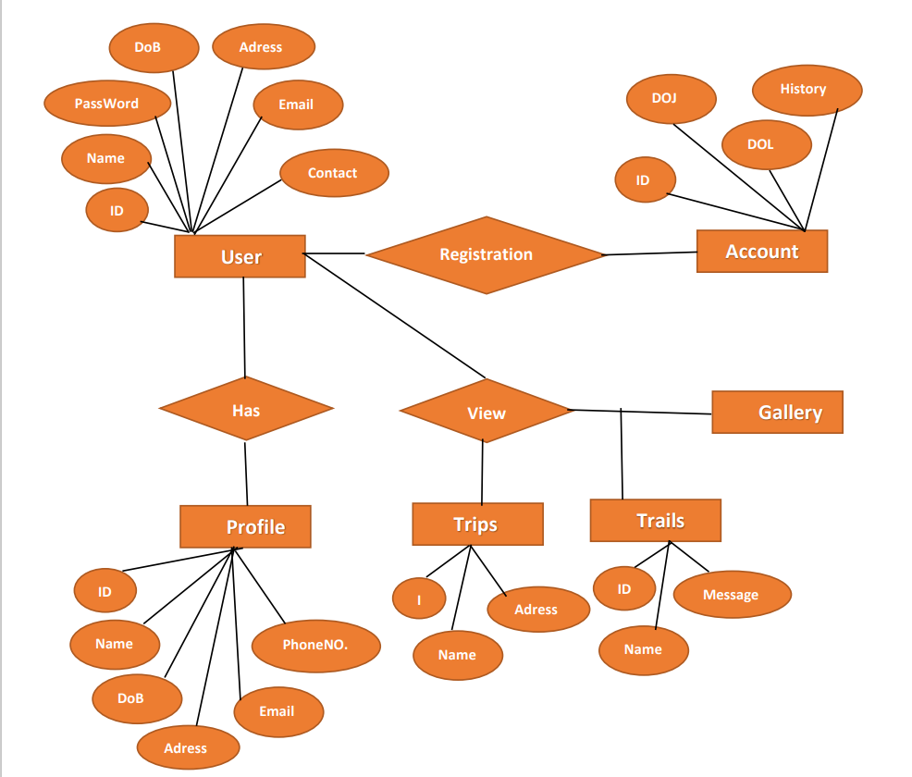
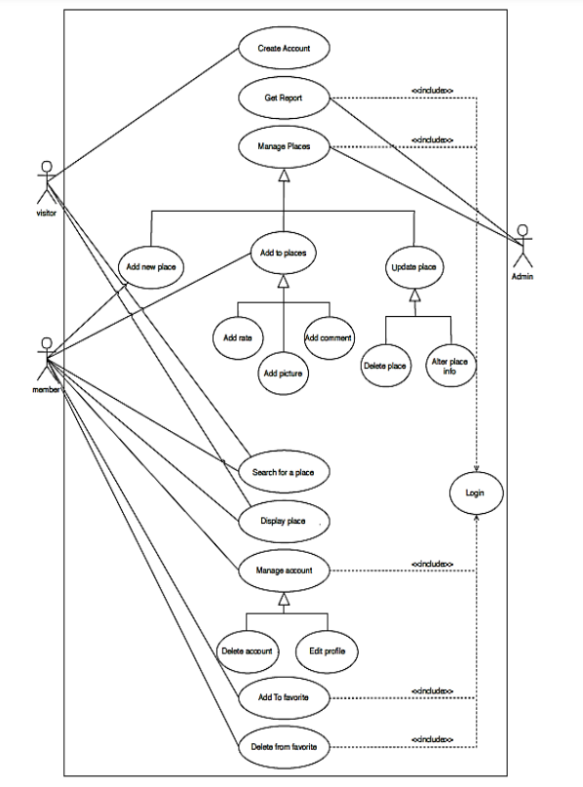
Database Design
ER Diagram

Slide 16
05.
UML Diagram

Slide 17
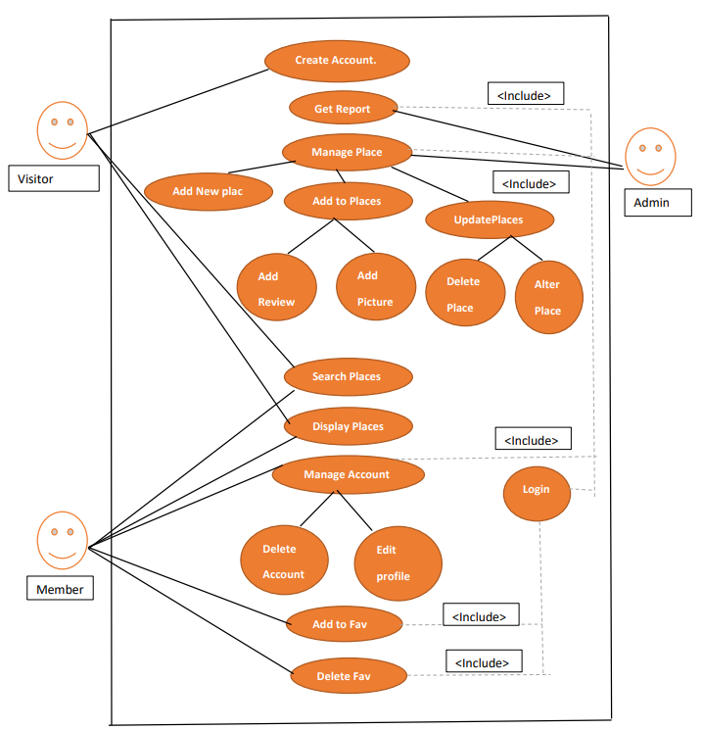
UML diagram is
visually representing a Travel system along with its main actors, roles, actions, artifacts or classes.

Slide 18
THANKS!
Now Feel Free to ask the Question ??

Slide 19
Find Buddy
Hobbies
Passion
What type of traveller
Nationality
Share your
Hobbies that u do in
Ur free time
Share your working
Professional
Select whether ur student, tourist, NRI, Trip vendor
Select the nation u are living

Slide 20
WHOA!
Exploring the world with new friends - let's connect and create unforgettable memories together!

Slide 21
“Find a travel companion and make your next trip unforgettable! Our travel buddy provider app will help you find the perfect match.”
— VAGA TRIP

Slide 22
References
[1] Abdulhamid S M and Usman G. Destination Information Management System for Tourist. arXiv
preprint arXiv:1402.1243, 2014.
[2] Muhammad A S and Usman G. Destination Information Management System For Tourist.
Computer Sciences and Telecommunications, 2010(6): 81-88.
[3] Abdulhamid S i M. A Distributed Information System for Tourists:
A Case Study of Niger State Tourism Destinations. Masters thesis, unpublished, 2010.
[4] Ukpabi D C and Karjaluoto H. Consumers’ acceptance of information and communications
technology in tourism: A review. Telematics and Informatics, 2017, 34(5): 618-644.

